Slide 1
Summary Extraction and Sentiment Analysis
Group - 6
Mentors - Karthik and Pallavi
GitHub Repository: Link
Streamlit App: Link
Akash Jathar
Dr.Manisha More
Onkar Shinde
Pradnya Patil
Saket Khatavkar

Slide 2
Business Objective
To extract E-books of your choice and extract summary ,categorize summary as positive, negative, and neutral. Build a NLP model to achieve the said objective with accepted accuracy of 75% and above.

Slide 3
What is Sentiment Analysis?
It is the process of determining the emotional tone behind a series of words, used to gain an understanding of the attitudes, opinions and emotions expressed within a corpus of text, speech or any mode of communication.
Also known as Emotion Mining
Importance of Sentiment Analysis?
To gain an overview of the wider public opinion behind certain topics.
Governments use it to gauge public opinion to policy announcements and campaign messages ahead of elections.
Essential tool for market research and customer service approach.
Understanding Customer Behavior.

Slide 4
Tools Used
To perform Sentiment Analysis
Python Open source libraries are used to preprocess online book summary and for complete text analysis
Model building process is done with Neural Network
Streamlit the Python Open Source library is used for Model Deployment

Slide 5
Sentiment Analysis Approaches
Sentiment Analysis
Using Supervised ML
Using Unsupervised ML

Slide 6

Project Workflow
Word Cloud
Check for data imbalance
Subjectivity and Polarity
GUI
EDA
Book summary input from user
Books’ summary Extraction
Data Cleaning
and
Pre-processing
Positive/ Negative/ Neutral
Data Cleaning
and
Pre-processing
Vectorization
Source site: Goodreads.com
Web-scraping : Beautiful Soup (BS4)
Extracted fields: Book title, Book Author, Summary, Book- cover image
ML model for Sentiment Analysis
TFIDF Vectorizer/ Word2Vec
(We will avoid using Count Vectorizer in this case.)
special character removal (regex).
lowercase, stopwords removal
Lemmatization
special character removal (regex).
lowercase, stopwords removal
Lemmatization

Slide 7
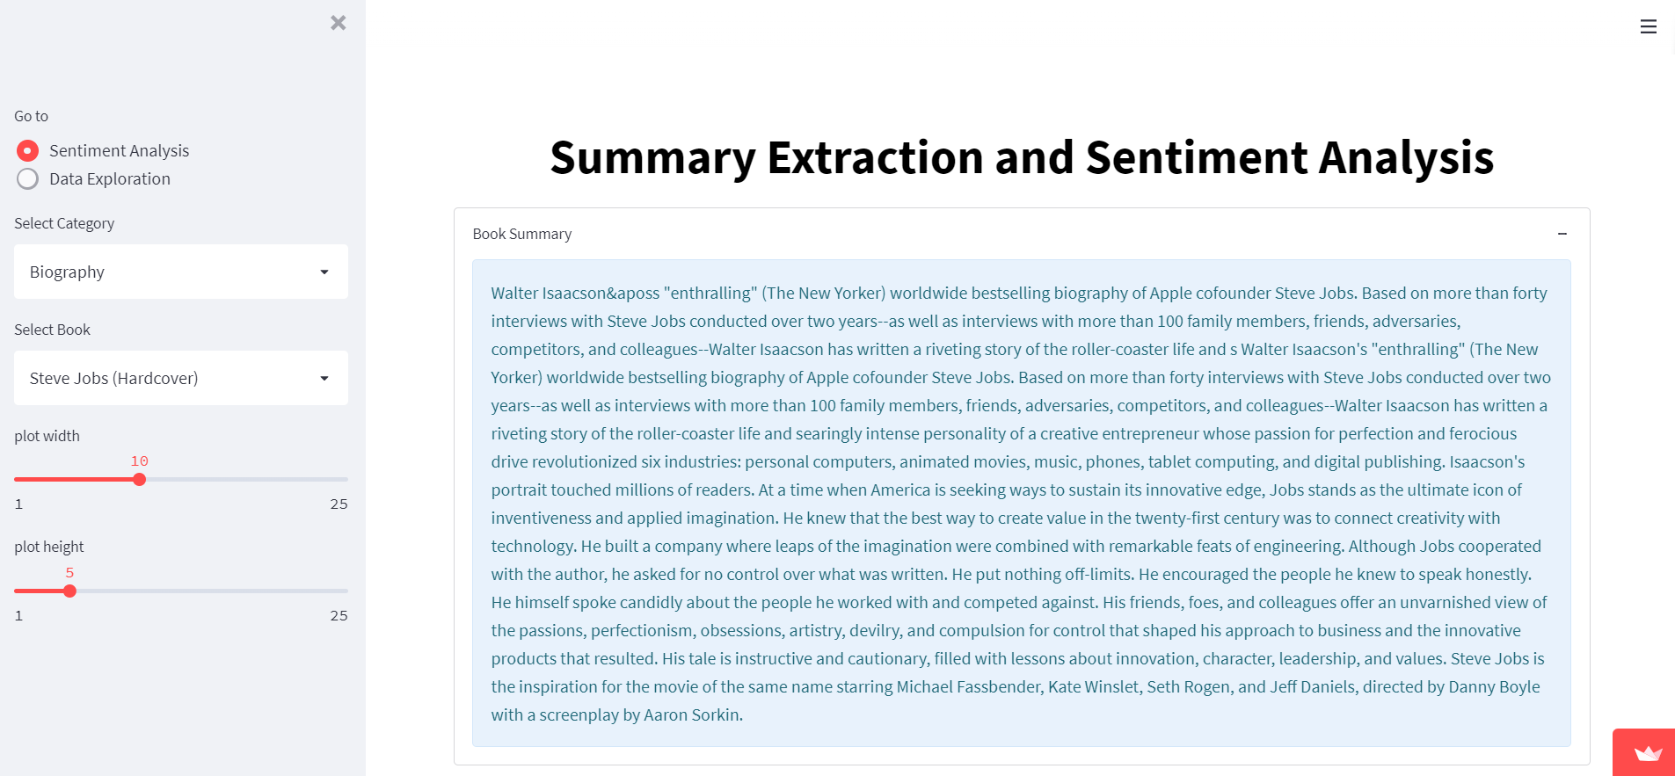
Final Dataset :

Slide 8
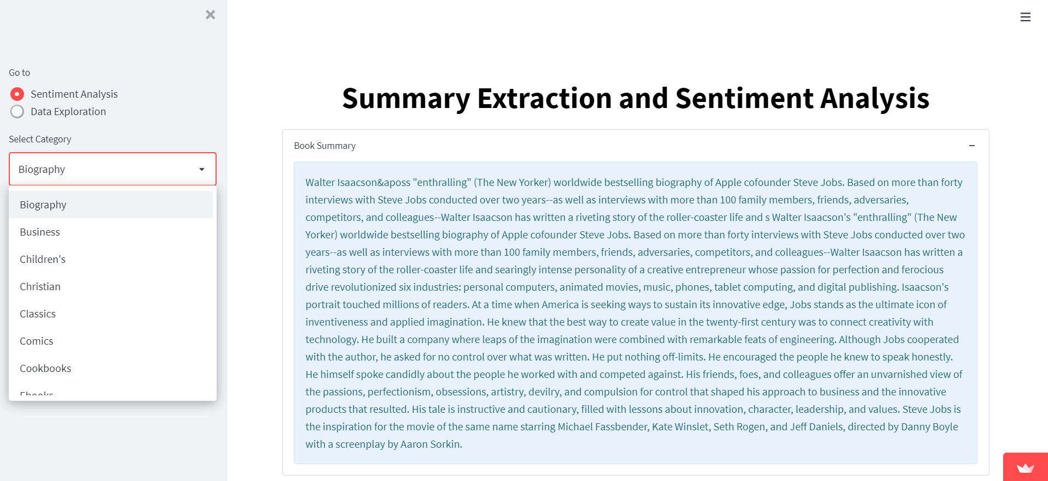

Slide 9
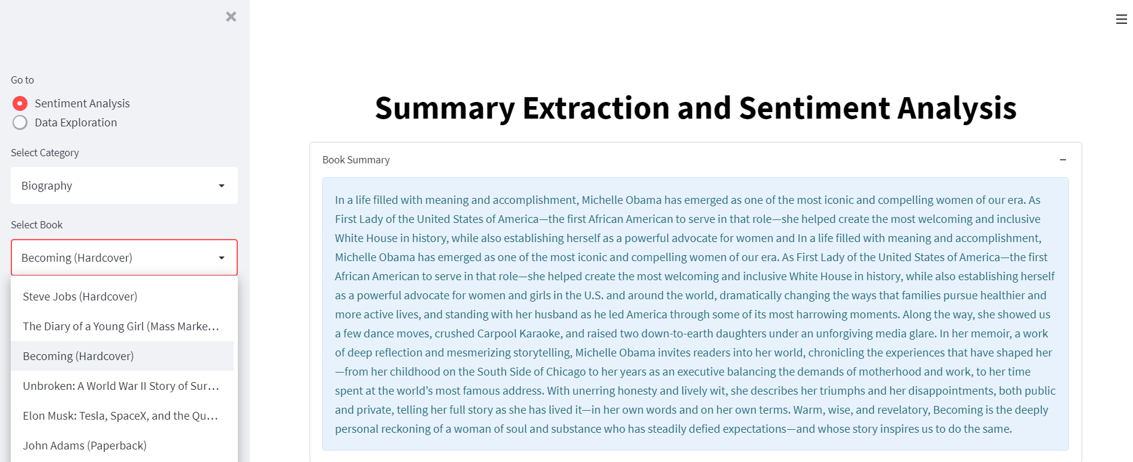

Slide 10
Exploratory Data Analysis
For Exploratory data analysis please check the document with detailed analysis
Document Link

Slide 11
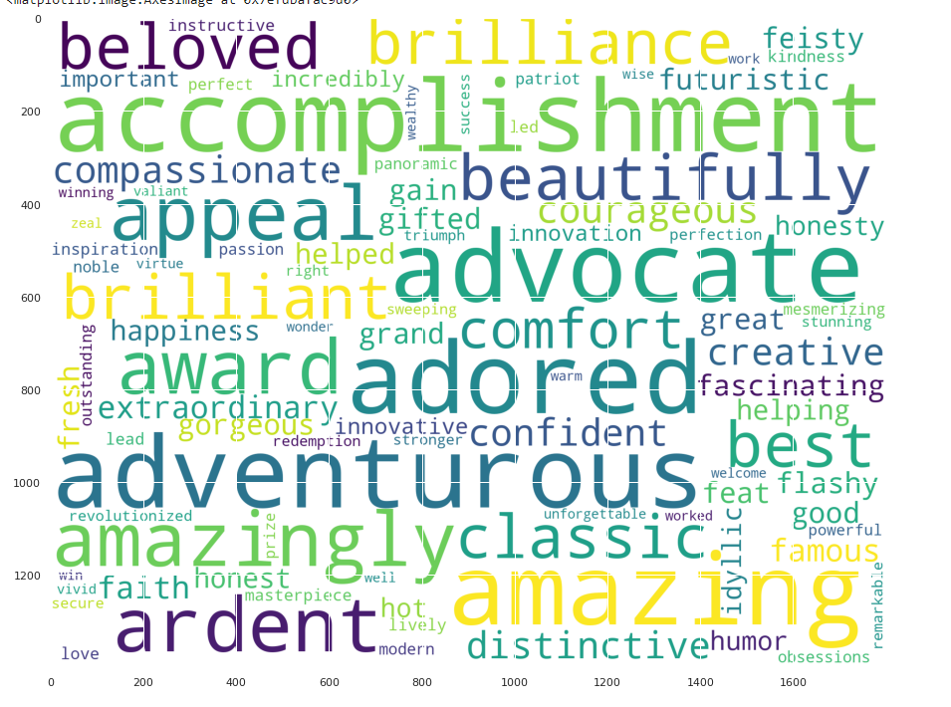
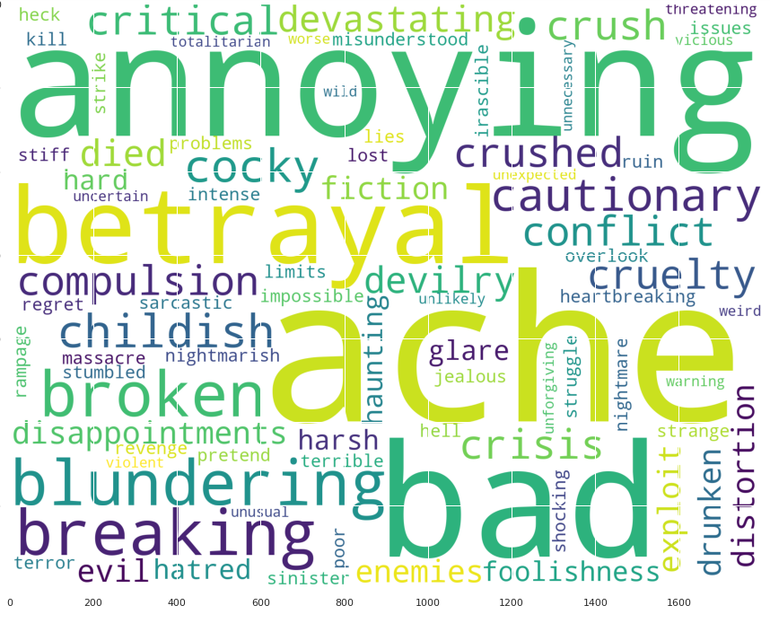
Basic EDA
Word Cloud
For Most common Words
Positive and Negative Words
Positive
Negative

Slide 12
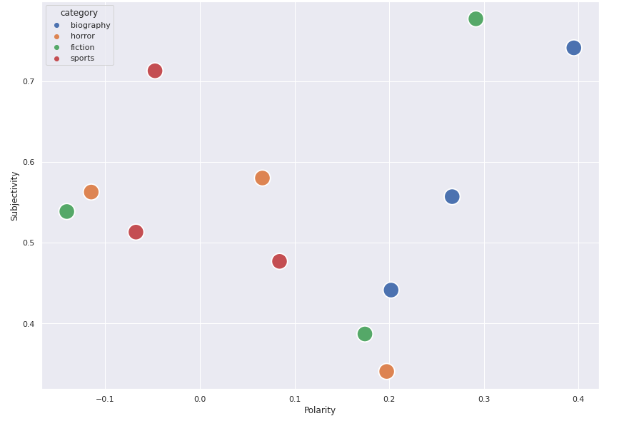
Insights into Book Summaries
Subjectivity and Polarity Analysis
Subjectivity is nothing but a sentence that expresses some personal feelings, views, or beliefs. Its values range from 0 to 1 where 0 is very objective and 1 is very subjective (Number of expressions)
while polarity simply means emotions expressed in a sentence. (Intensity of expressions)

Slide 13
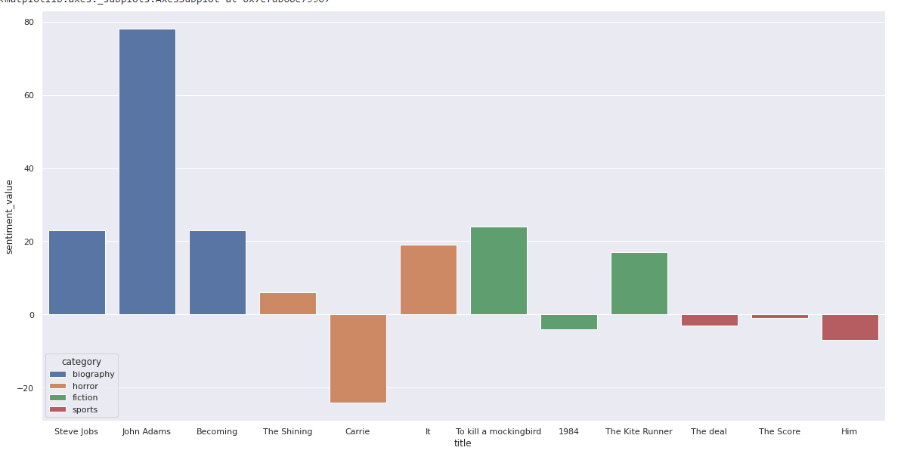
Insights into Book Summaries
Affinity Scores – semantic relations between the words (how close particular word is to positivity or negativity)
Gives us the sentiment values

Slide 14
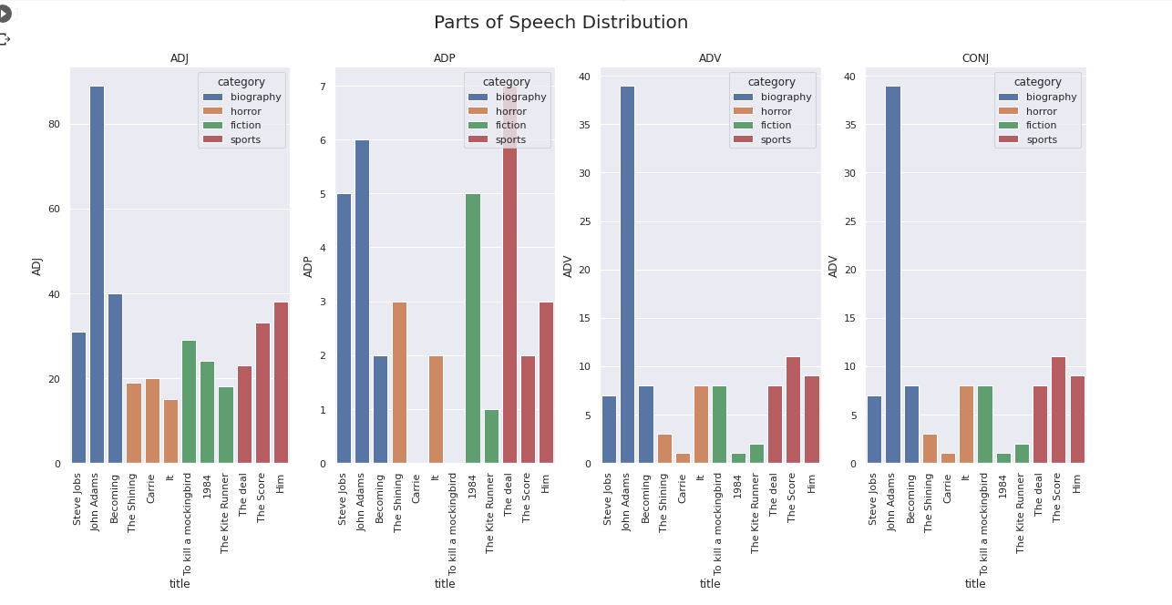
POS distribution

Slide 15
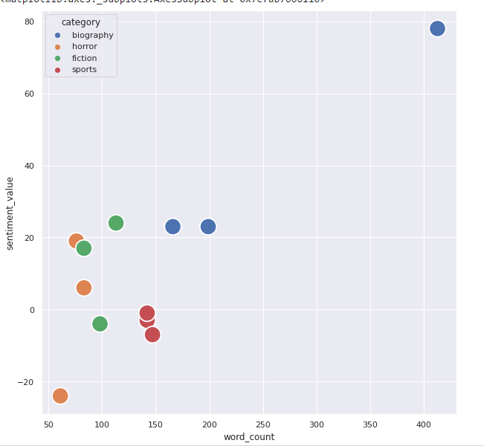
Effect of Word count on Sentiment Values
For detailed analysis please check the document Document Link

Slide 16
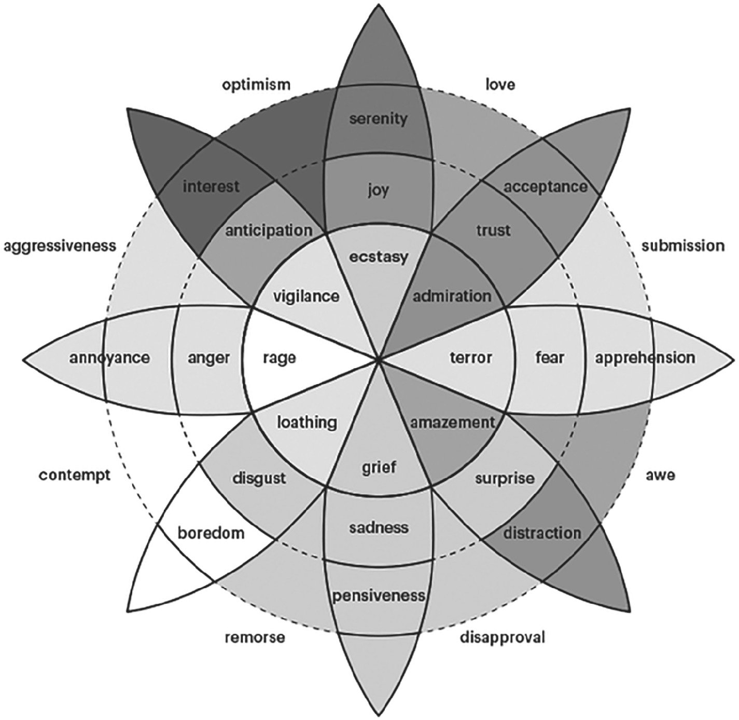
Emotion Scores
Provide the affective–cognitive understanding of the textual content
anger,
anticipation,
disgust,
fear,
joy,
sadness,
surprise,
trust,

Slide 17
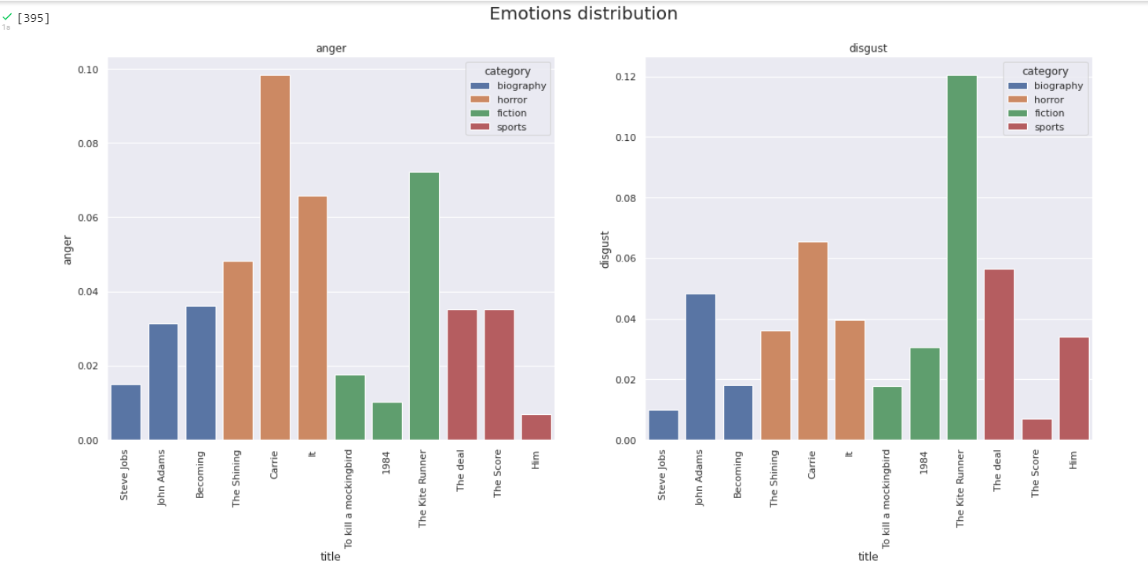

Slide 18
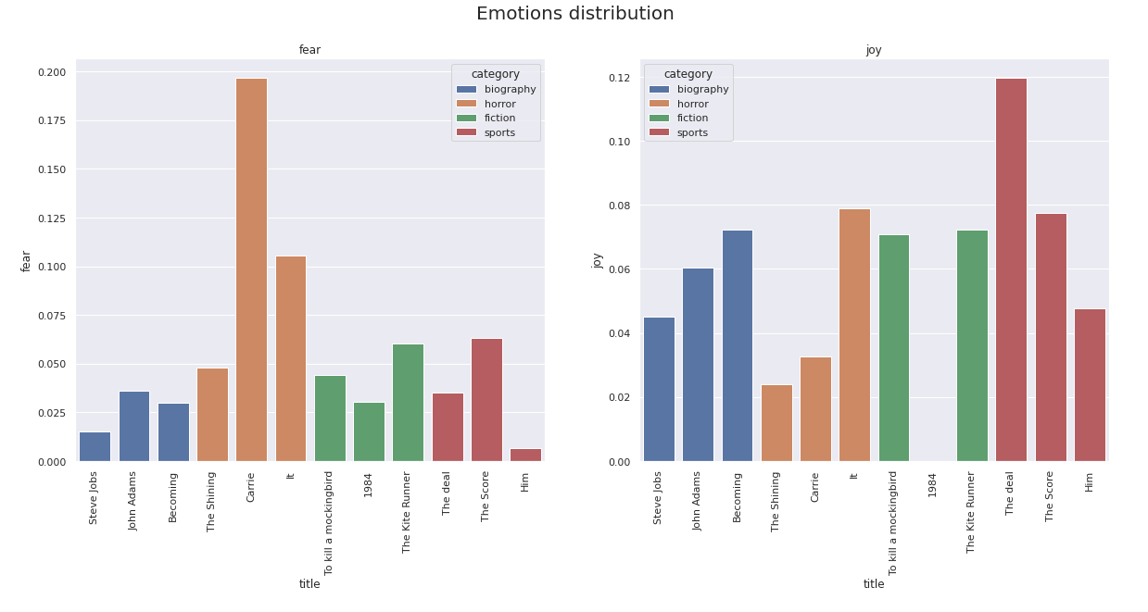

Slide 19
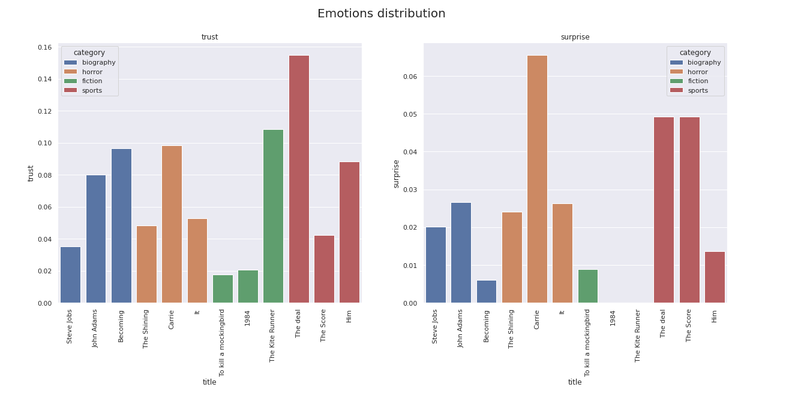

Slide 20
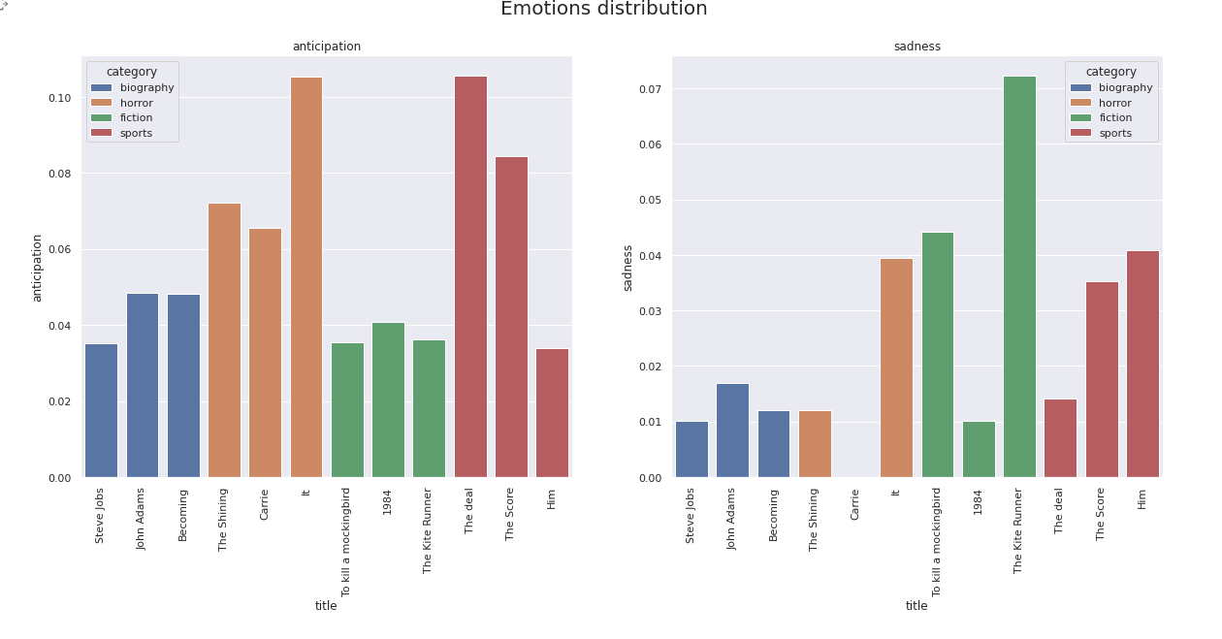

Slide 21
Model Building and Evaluation

Slide 22
Possible Approaches
There are two main approaches you could take, to teach an algorithm to distinguish between positive and negative emotions in writing — a supervised, and an unsupervised one.
Supervised algorithm would inquire from you to collect labeled data, and teach an algorithm in a supervised manner how each word in a sequence corresponds to the outcome of overall sentence being negative or positive. This approach requires manually labeled data.
The main idea behind Unsupervised algorithm is that you don’t give any previous assumptions and definitions to the model about the outcome of variables you feed into it — you simply insert the data (of course preprocessed before), and want the model to learn the structure of the data itself. It is extremely useful in cases when you don’t have labeled data, or you are not sure about the structure of the data, and you want to learn more about the nature of process you are analyzing, without making any previous assumptions about its outcome.
We are going to try both the algorithms for model building and we’ll select one with the accuracy >75%

Slide 23
Supervised/Hybrid
Supervised algorithm with data labelling and deep learning:
We extracted the summary for additional 1100 books from Goodreads [Dataset link]. For this we selected the books from diverse genres.
Further, we are going to use it as our training and evaluation dataset.
In order to come up with an ML model we need to Label this dataset first
Overall approach is depicted in the following figure.
Pre-processing and Vectorization
Machine Learning Model Building
(SVM, LR, Naïve Bayes, RF)
Testing on Extracted summary
Model Deployment
Data Labelling
Model Training and Evaluation

Slide 24
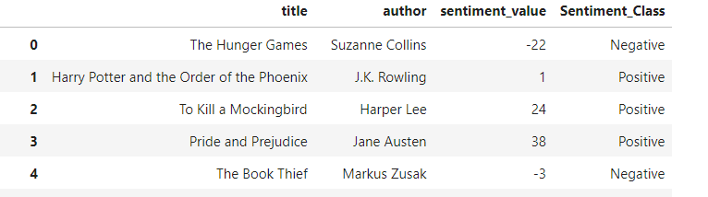
Data Labelling : Link
For data labelling purpose we used the pre-processed and vectorized summary data
With the help of NRCLex Positive, Negative sentiments we labelled this data
NRCLexicon is an MIT-approved pypi project
The package contains approximately 27,000 words and is based on the National Research Council Canada (NRC) affect lexicon and the NLTK library’s WordNet synonym sets.
For cross checking we used the sentiment values obtained from the affinity analysis in Exploratory data analysis
Labelled Data

Slide 25
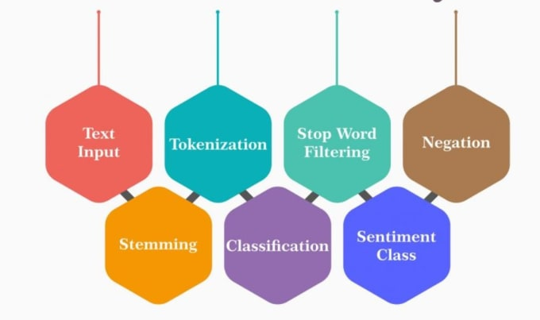
Data Pre-Processing
Here we will transform the texts into vectors using Term Frequency-Inverse Document Frequency (TFIDF) and evaluate how important a particular word is in the collection of words. For this we need to remove punctuations and do lower casing, then the word importance is determined in terms of frequency.
Data Cleaning
and
Pre-processing
Count Vectors can be helpful in understanding the type of text by the frequency of words in it but, It will just consider words that are abundant in a corpus as the most statistically significant word. It also doesn't identify the relationships between words such as linguistic similarity between words.
Hence, we have used TF-IDF or a combination of both wherever necessary. TF-IDF takes into account the frequency of a word in the corpus but it also provides a numerical representation of how important a word is for statistical analysis.
Vectorization
TFIDF Vectorizer/ Word2Vec/Count Vectorizer
(We will avoid using Count Vectorizer in this case.)
special character removal (regex).
lowercase, stopwords removal
Lemmatization

Slide 26
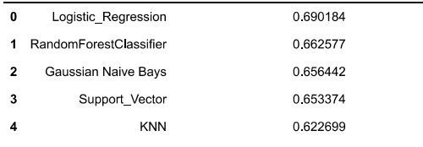
Model Building and Evaluation: Link
Model
Accuracy
Results on the left are obtained after hyper parameter tuning using GridSearchCV.
Deep Learning Model
We used 2 hidden layers in Neural Networks model and got the 100% train accuracy.
When running the model on test data the accuracy was fluctuating between 70-72%.
In order to avoid this overfitting scenario we have added dropout layers with dropping rate of 50%.
With this we got the maximum accuracy of 80-81% and the Average accuracy of 77%
Average Accuracy with Neural Network Model = 77.17%

Slide 27
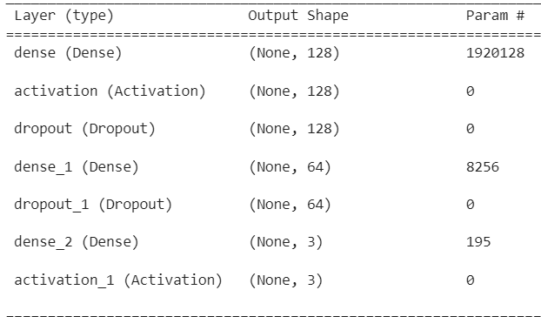
Final Model: Link
For Overall Book sentiment Analysis
Model : Neural Network
Dense Layers : 3 (128,64,64)
Max Word length : 15000
Drop out layers : 2 with 50% dropping rate
Optimizer : Adam optimizer
Epochs: 11, We want to run it for 11 epochs to be able to see how the training loss and accuracy are changing after each epoch.
Activation : Relu and Sigmoid for Output layer
Batch Size: 32, i,e, 32 samples are used in one forward/backward pass
Loss function: Categorical Cross Entropy
For Detailed Emotion Analysis
NRC Lexicon emotion scores are used for detailed sentiment analysis

Slide 28
Results
Tested the model on 3 different Book categories and got following results

Slide 29
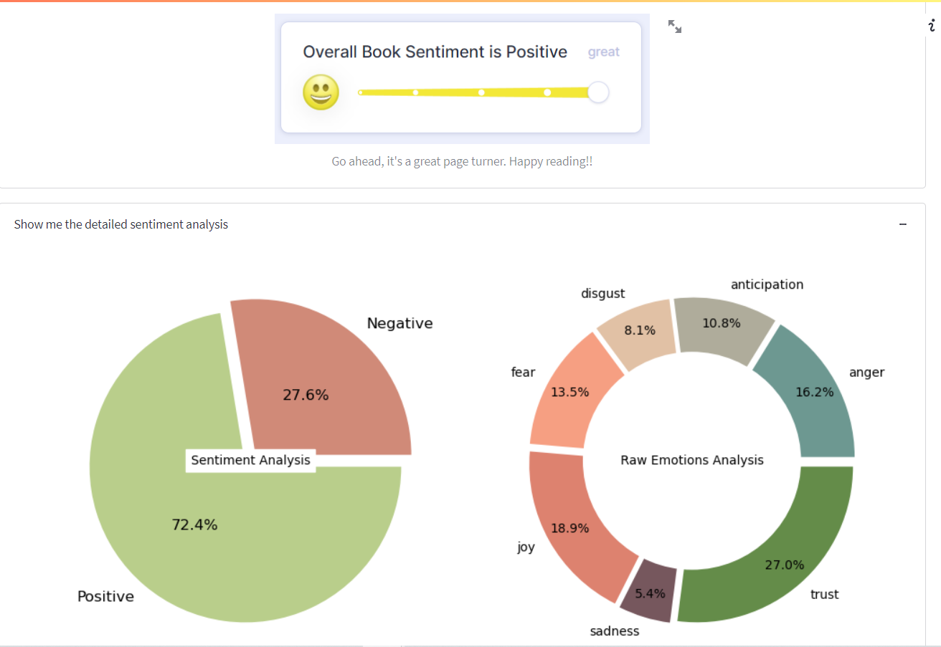
Final Results
Book Title : Becoming
Book Summary
In a life filled with meaning and accomplishment, Michelle Obama has emerged as one of the most iconic and compelling women of our era. As First Lady of the United States of America—the first African American to serve in that role—she helped create the most welcoming and inclusive White House in history, while also establishing herself as a powerful advocate for women and In a life filled with meaning and accomplishment, Michelle Obama has emerged as one of the most iconic and compelling women of our era. As First Lady of the United States of America—the first African American to serve in that role—she helped create the most welcoming and inclusive White House in history, while also establishing herself as a powerful advocate for women and girls in the U.S. and around the world, dramatically changing the ways that families pursue healthier and more active lives, and standing with her husband as he led America through some of its most harrowing moments. Along the way, she showed us a few dance moves, crushed Carpool Karaoke, and raised two down-to-earth daughters under an unforgiving media glare. In her memoir, a work of deep reflection and mesmerizing storytelling, Michelle Obama invites readers into her world, chronicling the experiences that have shaped her—from her childhood on the South Side of Chicago to her years as an executive balancing the demands of motherhood and work, to her time spent at the world’s most famous address. With unerring honesty and lively wit, she describes her triumphs and her disappointments, both public and private, telling her full story as she has lived it—in her own words and on her own terms. Warm, wise, and revelatory, Becoming is the deeply personal reckoning of a woman of soul and substance who has steadily defied expectations—and whose story inspires us to do the same.

Slide 30
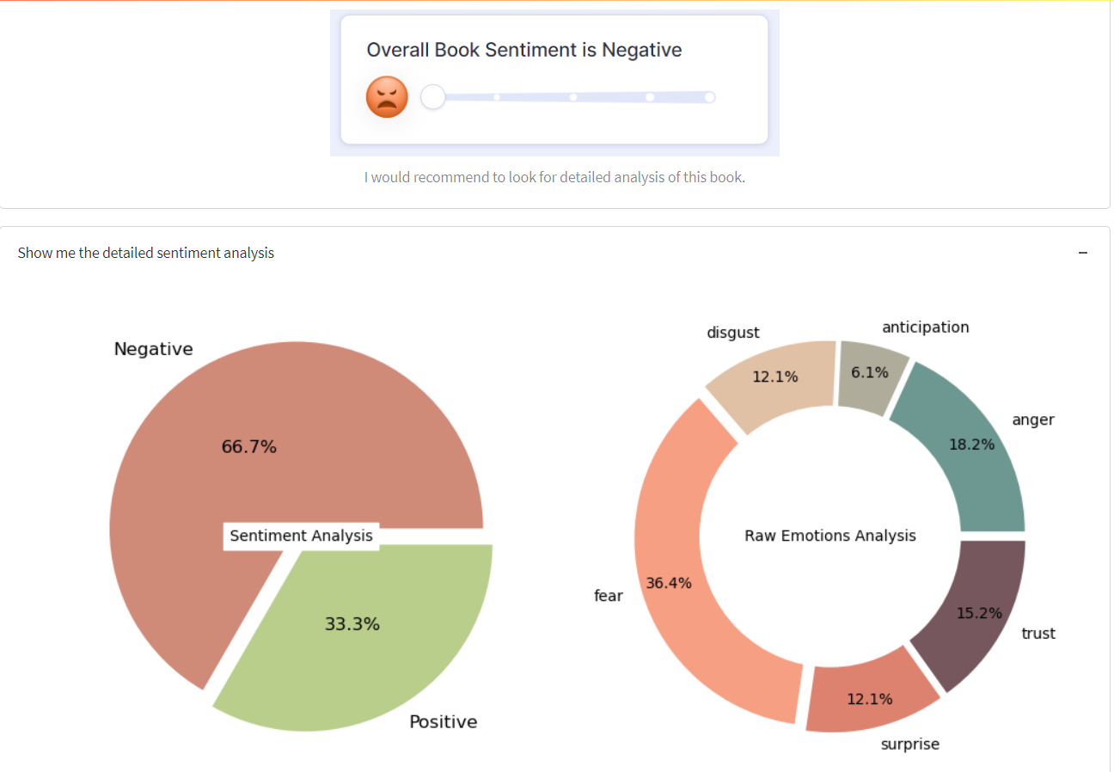
Final Results
Book Title : Carrie
Book Summary
A modern classic, Carrie introduced a distinctive new voice in American fiction -- Stephen King. The story of misunderstood high school girl Carrie White, her extraordinary telekinetic powers, and her violent rampage of revenge, remains one of the most barrier-breaking and shocking novels of all time.Make a date with terror and live the nightmare that is...Carrie--back cov A modern classic, Carrie introduced a distinctive new voice in American fiction -- Stephen King. The story of misunderstood high school girl Carrie White, her extraordinary telekinetic powers, and her violent rampage of revenge, remains one of the most barrier-breaking and shocking novels of all time.Make a date with terror and live the nightmare that is...Carrie

Slide 31
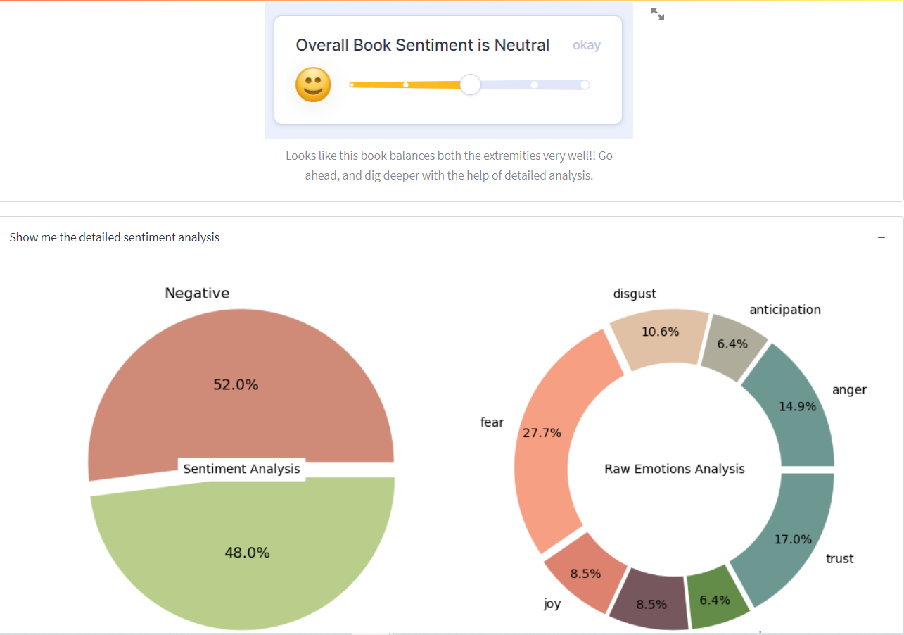
Book Title : Harry Potter and Sorcerer’s stone
Final Results
Book Summary
Harry Potter's life is miserable. His parents are dead and he's stuck with his heartless relatives, who force him to live in a tiny closet under the stairs. But his fortune changes when he receives a letter that tells him the truth about himself: he's a wizard. A mysterious visitor rescues him from his relatives and takes him to his new home, Hogwarts School of Witchcraft Harry Potter's life is miserable. His parents are dead and he's stuck with his heartless relatives, who force him to live in a tiny closet under the stairs. But his fortune changes when he receives a letter that tells him the truth about himself: he's a wizard. A mysterious visitor rescues him from his relatives and takes him to his new home, Hogwarts School of Witchcraft and Wizardry.After a lifetime of bottling up his magical powers, Harry finally feels like a normal kid. But even within the Wizarding community, he is special. He is the boy who lived: the only person to have ever survived a killing curse inflicted by the evil Lord Voldemort, who launched a brutal takeover of the Wizarding world, only to vanish after failing to kill Harry.Though Harry's first year at Hogwarts is the best of his life, not everything is perfect. There is a dangerous secret object hidden within the castle walls, and Harry believes it's his responsibility to prevent it from falling into evil hands. But doing so will bring him into contact with forces more terrifying than he ever could have imagined.Full of sympathetic characters, wildly imaginative situations, and countless exciting details, the first installment in the series assembles an unforgettable magical world and sets the stage for many high-stakes adventures to come.

Slide 32
Deploying Streamlit Application on GitHub
Steps Followed:
GitHub Repo Creation : Link
Added requirements.txt file for all the libraries used in project
Added details of the repo in the Streamlit share
Model deployment
Deployed app Link

Slide 33
Future Scope
Unsupervised Sentiment Analysis using Clustering:
The main idea behind this approach is that negative and positive words usually are surrounded by similar words could form clusters (based on similarity of their surrounding) of negative words that have similar surroundings, positive words that have similar surroundings, and some neutral words that end up between them .
Clustering (K means/DBSCAN)
Calculate Weighted sentiment scores and determine overall sentiment of a sentence
Model Evaluation
Preprocessing
Word2Vec
Calculate Sentiment Coeff.
(based on distance of words from its centroids)
Extracted summary
Summary from Goodreads
Streamlit GUI
Sentiment analysis
Detailed Book Sentiment
Reference : https://towardsdatascience.com/unsupervised-sentiment-analysis-a38bf1906483

Slide 34
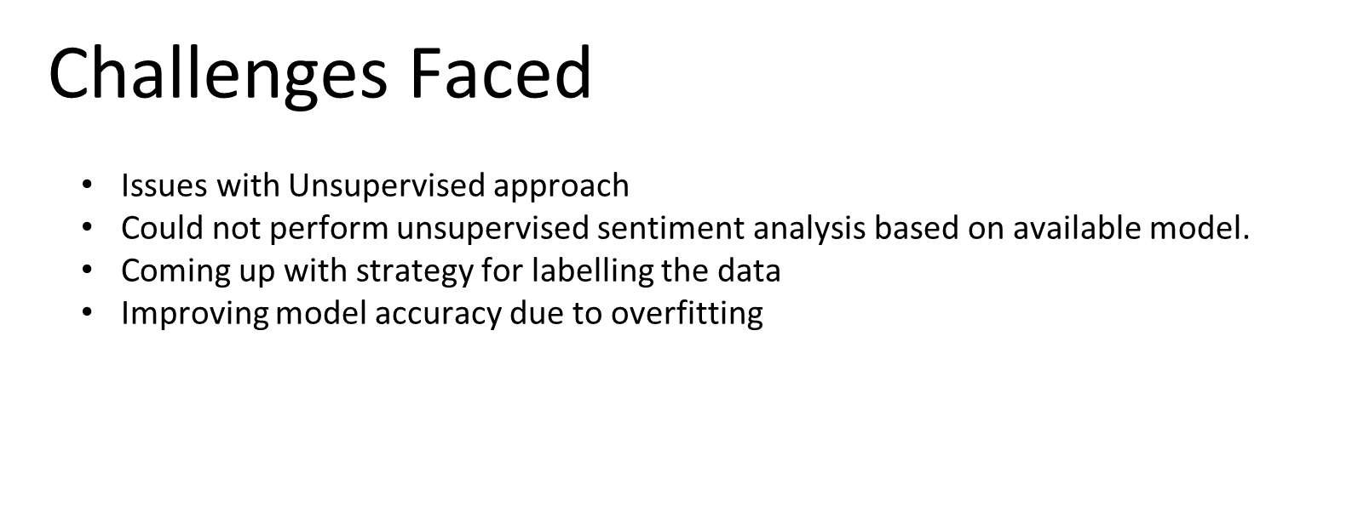

Slide 35
Thank You!

